Slide 1

The Mobile Web
Mark Branom
Continuing Studies CS 22

Slide 2
Topics
Concerns, concepts, and strategies
Why mobile matters
Responsive Design
Mobile First!
Mobile app vs. Native app

Slide 3
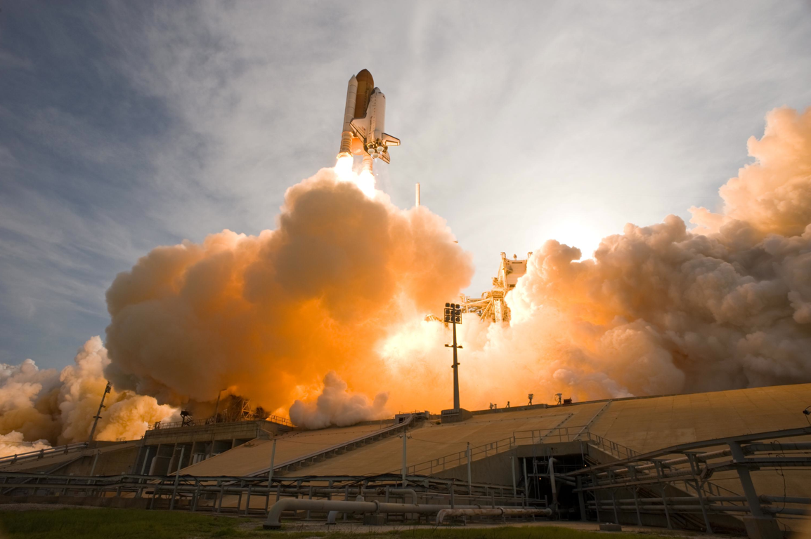
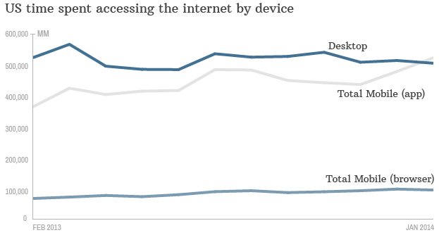
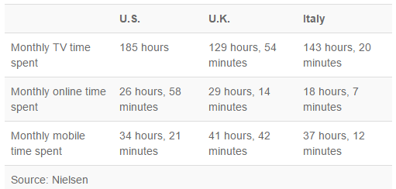
Why Mobile Matters
Mobile access > non-mobile
Notes:
http://money.cnn.com/2014/02/28/technology/mobile/mobile-apps-internet/
http://www.nielsen.com/us/en/insights/news/2014/how-smartphones-are-changing-consumers-daily-routines-around-the-globe.html
http://www.flickr.com/photos/soldiersmediacenter/3729394795/

Slide 4
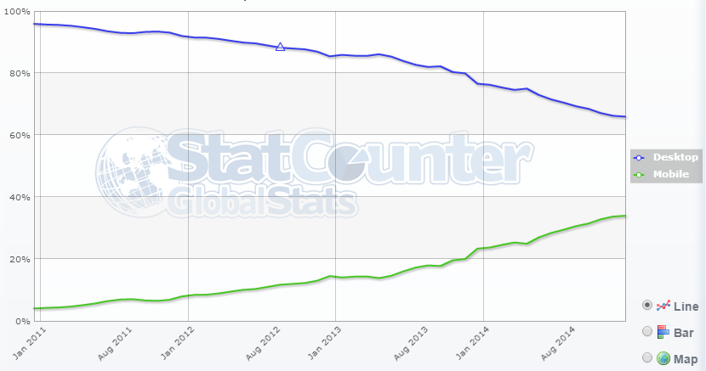
Why Mobile Matters
Nearly 40% of web traffic viewed on mobile devices
59% of people have viewed website on phone, then followed up on desktop
34% have done the reverse
Notes:
http://gs.statcounter.com/#mobile_vs_desktop-ww-monthly-201012-201412
Morgan Stanley, via http://mashable.com/2010/04/13/mobile-web-stats/

Slide 5
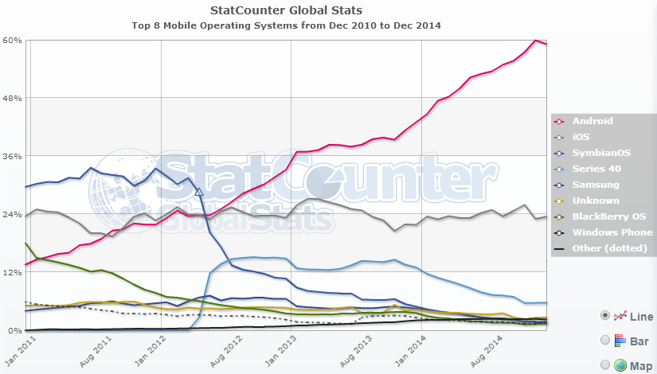
Worldwide Mobile Operating Systems
Notes:
http://gs.statcounter.com/#mobile_os-ww-monthly-201012-201412

Slide 6
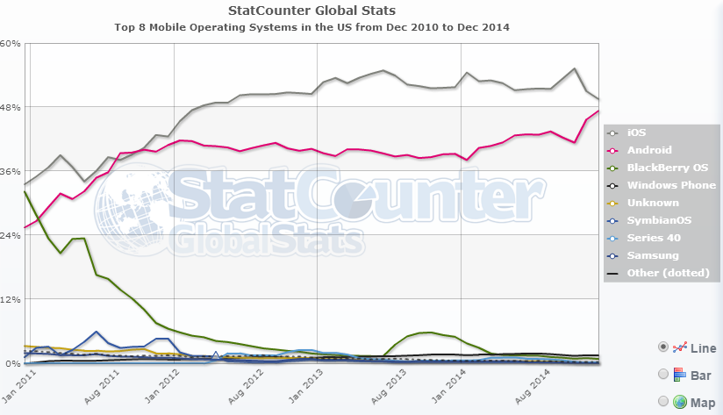
US Mobile Operating Systems
Notes:
http://gs.statcounter.com/#mobile_os-US-monthly-201012-201412

Slide 7

Speed Matters
17% of people will not wait more than 5 seconds for a mobile web site to load
Gomez “When Seconds Count”
Notes:
Gomez When Seconds Count report http://www.gomez.com/wp-content/downloads/GomezWebSpeedSurvey.pdf
http://upload.wikimedia.org/wikipedia/commons/d/d0/FA-18_Hornet_breaking_sound_barrier_%287_July_1999%29.jpg

Slide 8

Speed Matters
Google breaks down mobile users
into
3 behavior groups
Repetitive now
Bored now
Urgent now
Notes:
Repetitive now - deleting mail in the morning
Bored now - need something to do while in line, waiting for meeting to start, etc.
Urgent now - I’m running late, which gate is my plane leaving from?
http://www.flickr.com/photos/benlanc/4786607582/

Slide 9

Where is mobile used?
82% of mobile web use at home
Waiting in line
Most tablet use 6pm - 10pm
Notes:
http://www.flickr.com/photos/johanl/5619897608/

Slide 10
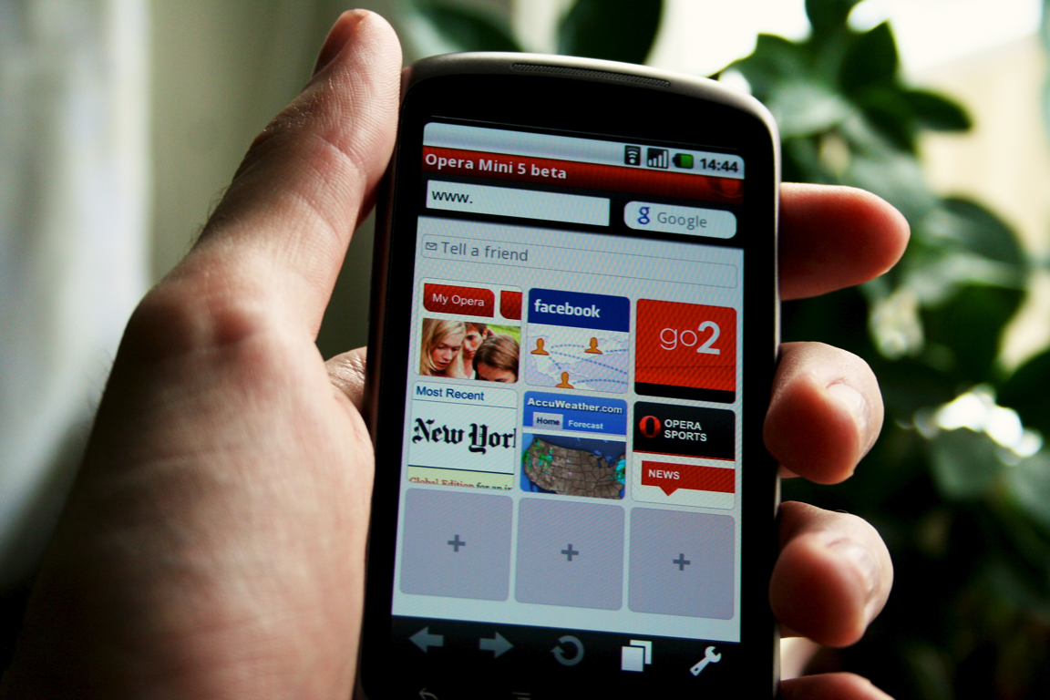
Mobile Browser Environment
Good Browsers
iOS, Android, Opera Mobile, new Blackberry
Support most of HTML5, CSS3, JS
Not So Good Browsers
Feature phones and everything else
No support for HTML5, CSS3 or JS
@ppk's mobile browser feature compatibility list
http://www.quirksmode.org/mobile/
Notes:
People don't really surf the web using the bad browsers, unless they have to
http://www.flickr.com/photos/johanl/4424185115/

Slide 11
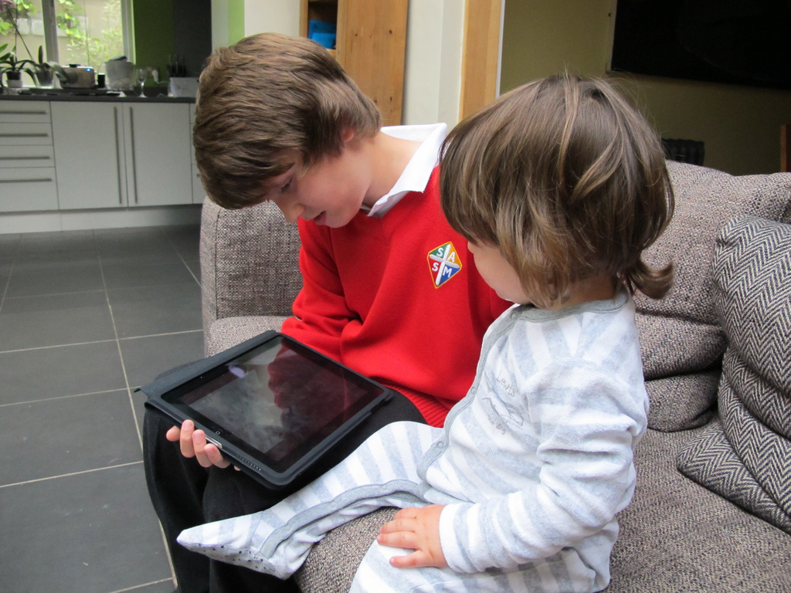
Mobile is Personal
Anywhere, anytime access
Access to user location, camera, address book, phone functionality, etc.
Touch and gesture control
Even babies can play games on the iPad
Notes:
http://www.flickr.com/photos/antmcneill/4686147794

Slide 12
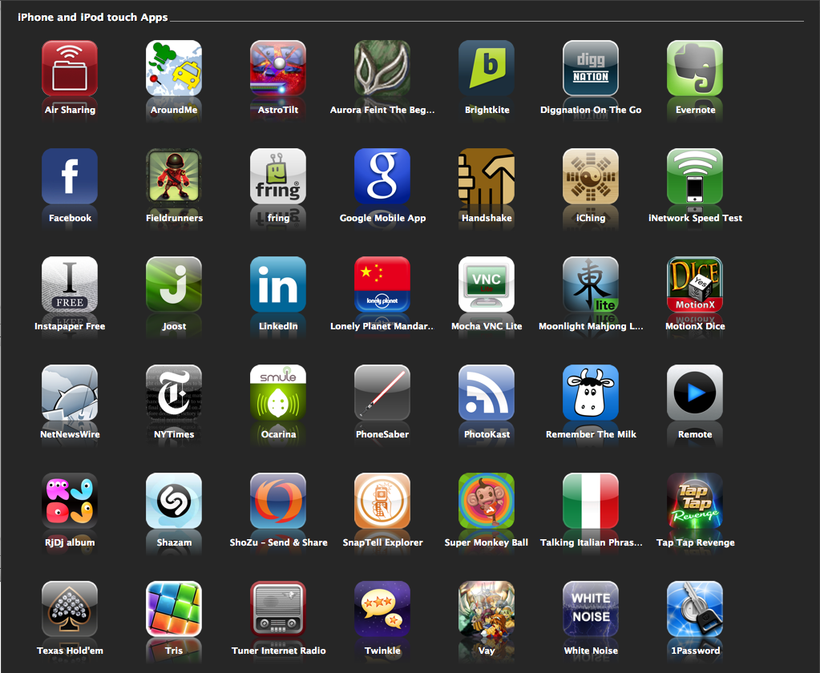
Apps
What is an App?
Everyone wants Apps
Do you really need one?
Native or Web App?
Notes:
Brian Fling @fling #bdconf offers clients a web app for less than full cost, because it’s the right thing to do; client always choose to pay more for a native app
http://www.flickr.com/photos/kaioshin/3085642914/

Slide 13

Native App
Coded in multiple languages, tools:
Objective C, Xcode, and Swift (iOS)
Eclipse and Java or C++ (Android)
.Net Studio and C# (Windows Phone 7)
Code cannot be reused across platforms :(
In app stores, with 300,000 other apps
Notes:
http://www.flickr.com/photos/23379658@N05/3650125866/

Slide 14

Web App
Coded in HTML5, CSS 3, and Javascript
Do it once and available everywhere
Can be installed on phone
Can be cached locally
even work offline
Access to local storage
Notes:
Well, mostly everywhere... might need some tweaks
Installed web pages have icons like regular apps
W3C and others are working on device APIs; security remains an issue (for regular web pages)
There’s standardization work on device APIs at http://www.wacapps.net/web/portal too
http://www.flickr.com/photos/schmish/4090562160/

Slide 15

Hybrid Solutions
Wrap your web app in a native app
Device access (camera, contacts, etc)
Available in app stores
Open source
PhoneGap – http://phonegap.com
Commercial
Appcelerator Titanium - http://www.appcelerator.com/
Notes:
http://www.flickr.com/photos/kitkaphotogirl/3516722887

Slide 16
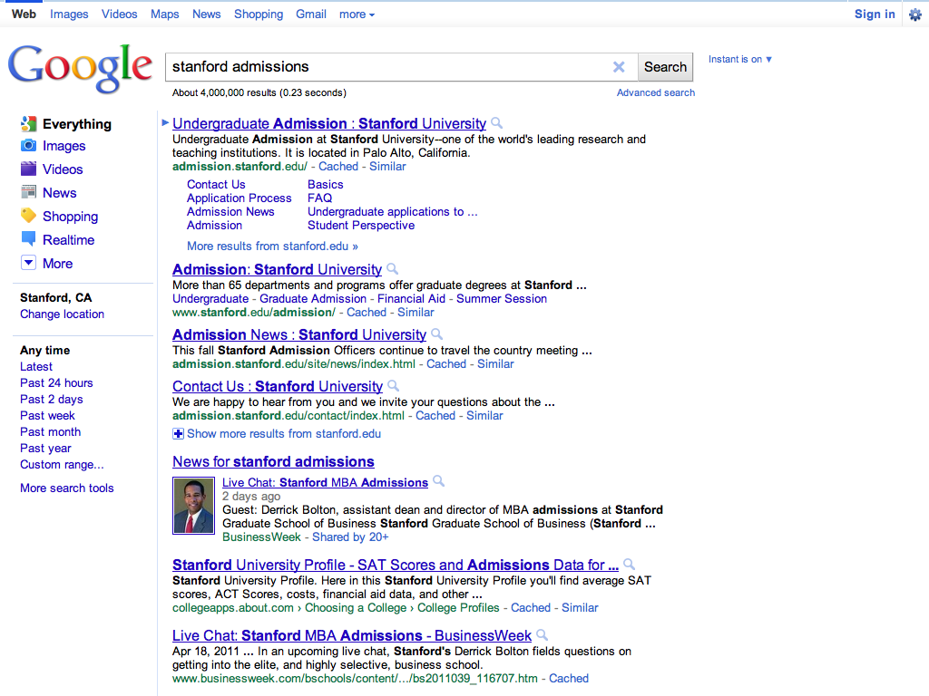
Still need a web site
Visitors and other non local users
Search
Returns links
Google does not distinguish between desktop or mobile sites
Feature phones
Phones you don't build for
Notes:
SEO is all about links
While you can create links to apps (on most devices), they’ll fail horribly if the user doesn’t have the app installed

Slide 17
Mobile Web!

Slide 18
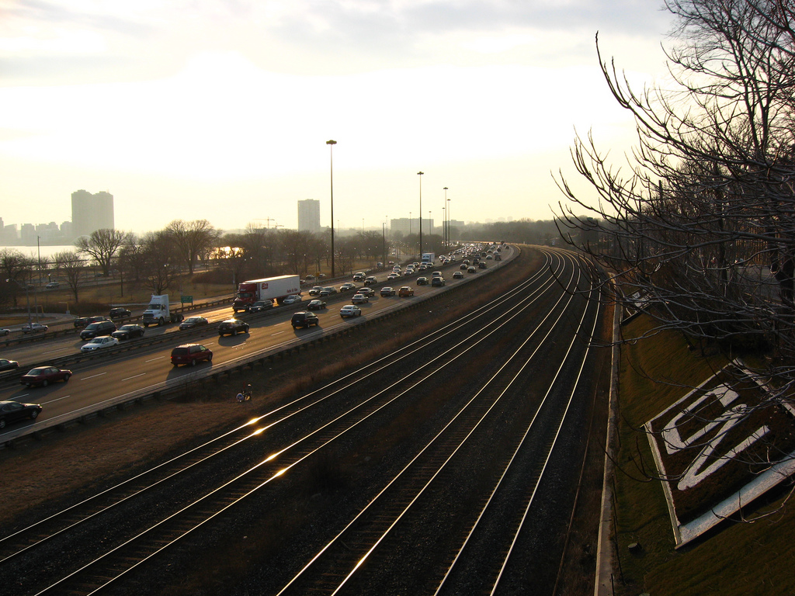
Separate Mobile Site
Used to be the way to do it
When devices had very limited browsers
More maintenance
What about new devices?
Device detection scramble
Usually means a redirect [BAD]
Notes:
http://www.flickr.com/photos/peterblanchard/3387759956

Slide 19
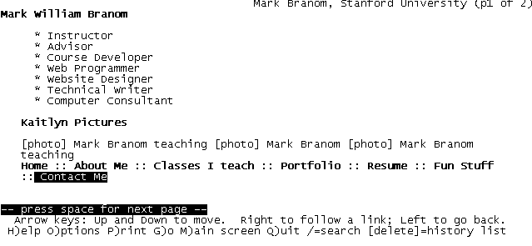
Progressive Enhancement
Deliver a simple site
Enhance it based on the capabilities of the browser
Media Queries
Feature detection (Modernizr)
JavaScript
CSS3 features
Notes:
lynx is the ultimate test of content first / progressive enhancement

Slide 20
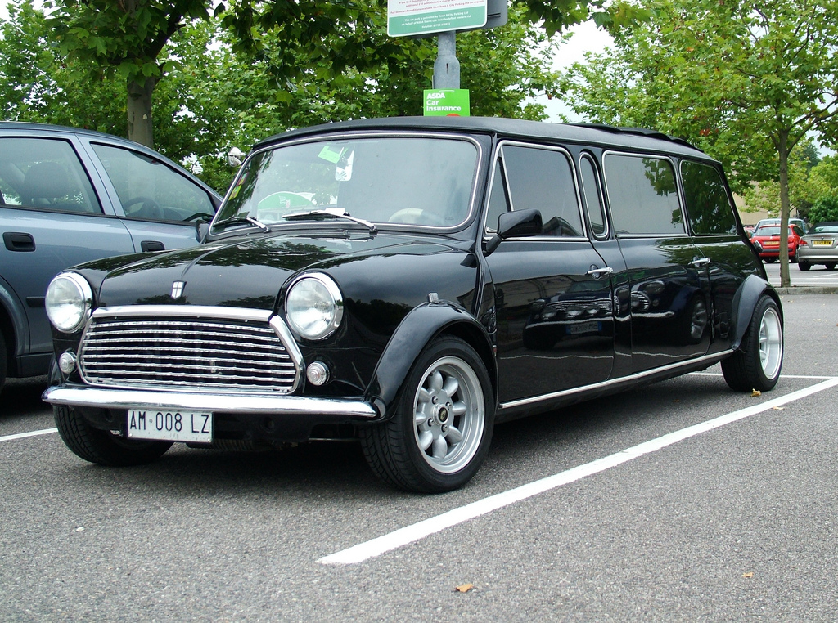
Responsive Design
Website should display content reasonably regardless of device resolution / orientation
fluid grids, CSS 3 layouts
content priority is maintained
content adjusted to the viewable space
text scaled to maintain content readability
Ethan Marcotte’s article http://www.alistapart.com/articles/responsive-web-design/
Notes:
Original Responsive Web Design article: http://www.alistapart.com/articles/responsive-web-design/
http://www.flickr.com/photos/kenjonbro/3796564454

Slide 21
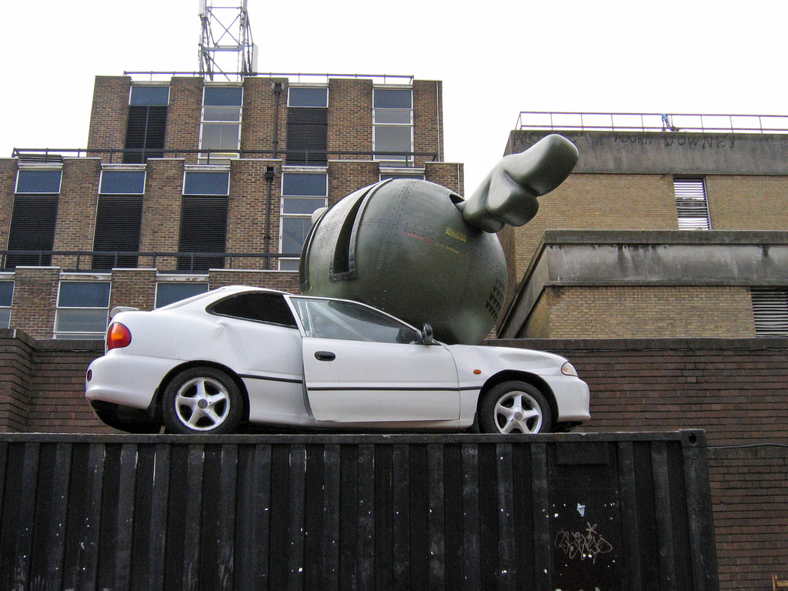
Ethan was mostly right
He was wrong about images
Suggested using largest needed image
Letting the browser resize
Really bad for performance
Jason Grigsby: resize images on server http://www.cloudfour.com/css-media-query-for-mobile-is-fools-gold/
Notes:
@grigs’ response to responsive design: http://www.cloudfour.com/css-media-query-for-mobile-is-fools-gold/
http://www.flickr.com/photos/daveknapik/402730950/

Slide 22

Mobile First!
Luke (@lukew) Wroblewski's Mobile First Talk
http://www.lukew.com/ff/entry.asp?1137
Mobile constraints improve design
Limited screen real estate on mobile
One distracted eyeball, one fat finger
Present only the most important content
Better usability = Better experience!
Notes:
@lukew’s mobile first talk http://www.lukew.com/ff/entry.asp?1137
http://www.flickr.com/photos/radioflyer007/4117675229

Slide 23

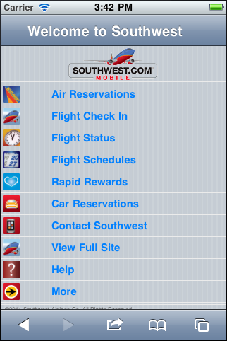
Desktop vs Mobile

Slide 24

or is it Content First?
Site Architecture
Many people ignore and forget this
Using all your content might not be the answer
But mobile users often want it all
What do mobile users need on your site?
Use analytics
Notes:
http://www.flickr.com/photos/wscullin/3770015203/

Slide 25

Why Analytics?
Mind reading is no way to base fundamental content decisions
Notes:
http://www.flickr.com/photos/mountain-top/3144841264

Slide 26
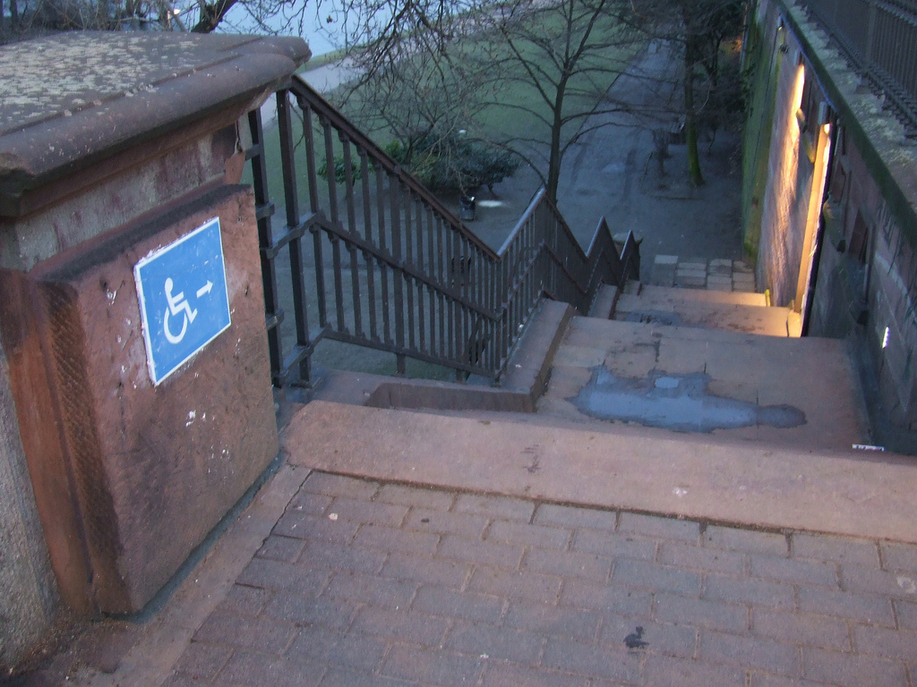
Accessibility
If I can't use your awesome website... It's not really that awesome, is it?
Make content accessible by everyone
Content accessibility > Presentation styles
Notes:
While you’re redesigning your site, make sure you keep it accessible
Avoid fixed viewports
http://www.flickr.com/photos/mniemand/3338678704

Slide 27

Viewports
Mobile browsers default to 960px wide
but scaled down
Fine for desktop sites, not for mobile sites
Set the viewport...
carefully
Notes:
http://www.flickr.com/photos/nodomain1/306390955

Slide 28
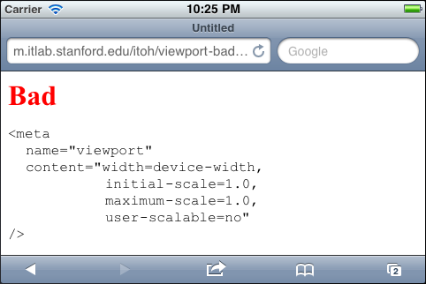
Bad Viewports
Pinch and Zoom to
Notes:
Some frameworks do this; many tutorials suggest this
Works more like a native app!

Slide 29
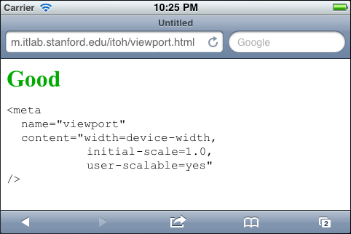
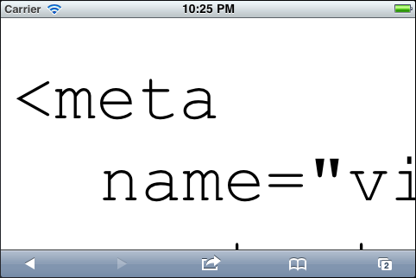
Good Viewports
Pinch and Zoom to
Notes:
Lets user pinch and zoom to see details, or to make controls more readable and more accessible

Slide 30

Performance and Optimization
Mobile devices often suffer from
Low bandwidth
High latency
Unreliable connectivity
Slower processors
Browsers only use 2,4, or 6 connections to a site
Notes:
RFC2616 (HTTP 1/.1 specification), section 8.1.4 "Practical Considerations" states: A single-user client SHOULD NOT maintain more than 2 connections with any server or proxyhttp://www.flickr.com/photos/danielfoster/2206175625

Slide 31
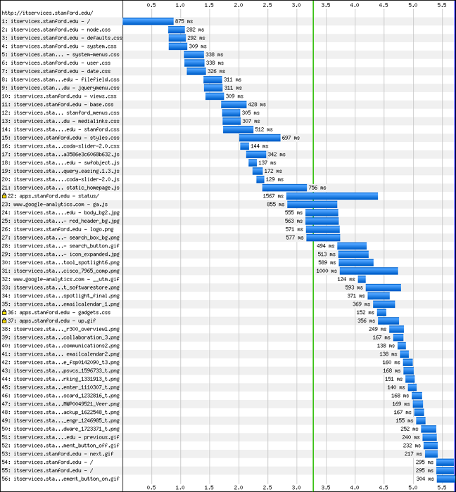
How Pages are Fetched
iOS uses up to 6 connections
http://www.spasche.net/files/parallel_connections
Notes:
Use firebug in firefox, or the web console in Safari / Chrome to see requests made by browser
This is from blaze.io, but Firebug in Firefox and the web console in Safari / Chrome also provide similar tools

Slide 32
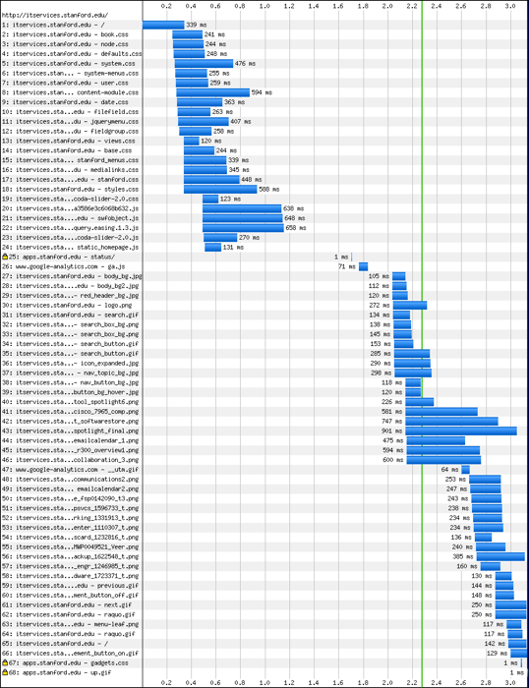
How Pages are Fetched
Android uses up to 11 connections!
http://www.spasche.net/files/parallel_connections
Notes:
This is from blaze.io, but Firebug in Firefox and the web console in Safari / Chrome also provide similar tools

Slide 33
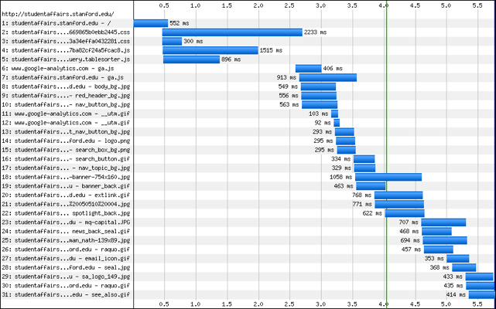
Performance Rules
Aggregate and minimize your CSS and Javascript
But look at all those images!
Notes:
Aggregate & minimize CSS & Javascript, using tools like http://developer.yahoo.com/yui/compressor/ http://refresh-sf.com/yui/

Slide 34

Images
Resize images on the server
For images used in CSS
Base64 encode images, embed in CSS http://www.websiteoptimization.com/speed/tweak/inline-images
Use CSS sprites http://www.alistapart.com/articles/sprites
Notes:
tinysrc and wurfl cache images
Base64 encoding images: http://www.websiteoptimization.com/speed/tweak/inline-images/
CSS sprites: http://www.alistapart.com/articles/sprites/
http://www.flickr.com/photos/andersondotcom/482150154

Slide 35
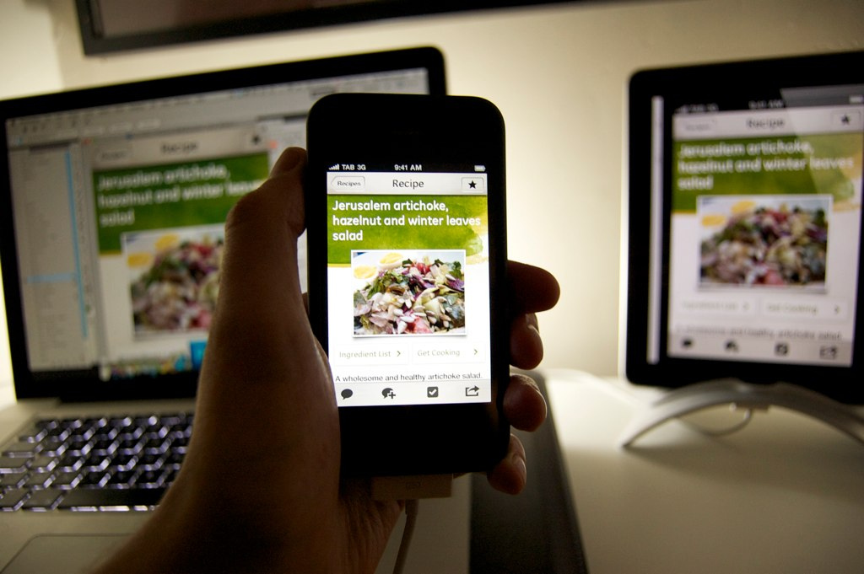
Testing
Emulators / simulators work, up to a point
May need Mac and Windows hosts
Test with real devices
On real networks (3g, Starbucks wifi)
In real conditions
Outside in sunshine
In classrooms
Notes:
iOS simulator is part of XCodeAndroid emulator on Linux, Mac, Windows
Use desktop browsers with performance tools
Use YSlow, etc.
http://www.flickr.com/photos/konch/4974020028

Slide 36
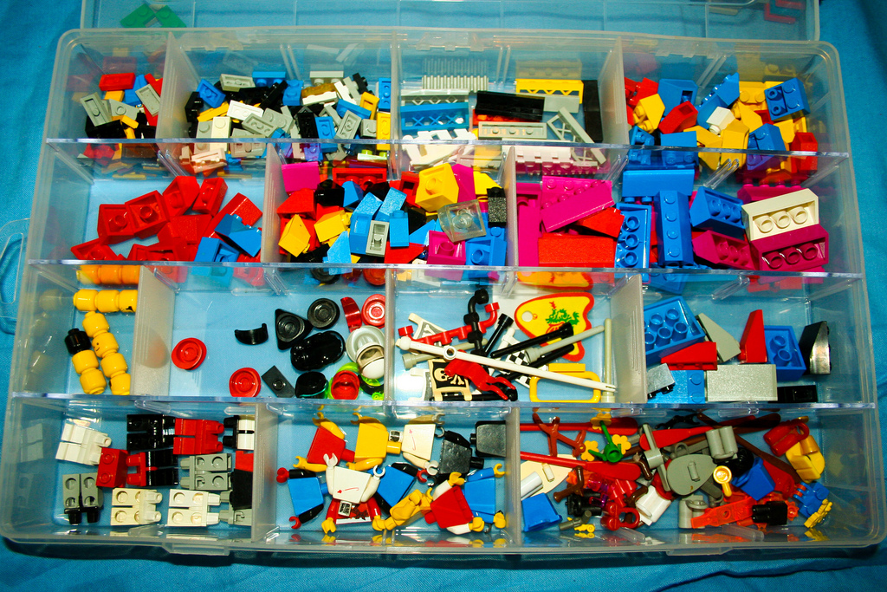
Managing a Mobile Site
Content Management and Maintenance
Use database or CMS to manage content
Reuse and publish content to multiple locations
Web Analytics
Track usage and behavior
Justify the need for mobile optimized sites
Continual Improvement
Notes:
http://www.flickr.com/photos/jemsweb/4363548805

Slide 37

Some thoughts on a mobile framework…
JQuery Mobile for mobile framework
UI elements
Base style
Modernizr for feature detection http://www.modernizr.com/
Media queries for screen size detection
Simple backend device classification
Notes:
Modernizr - http://www.modernizr.com/
http://detectmobilebrowser.com/ generate detection scripts for common languages, and mod_rewrite
http://www.flickr.com/photos/jillclardy/3651849999/

Slide 38

Mobile Framework Showcase
Examples of mobile aware web developed using a mobile framework
JQuery Mobile
http://www.jqmgallery.com/2011/06/10/stanford/
Sencha Touch
http://itservices.stanford.edu/service/web/mobile/developers/frameworks
Notes:
http://www.flickr.com/photos/nocallerid_man/3638360458

Slide 39
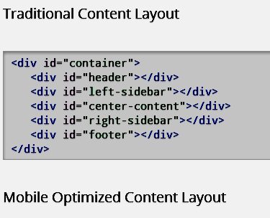
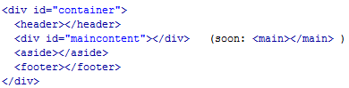
Developing for Mobile – Mobile First
Well-Structured Content

Slide 40
Screen Resolutions
See http://viewportsizes.com/ for the latest in screen resolution sizes!

Slide 41
Viewport
The viewport is the area that determines how content is laid out and where text wraps on the webpage. The viewport can be larger or smaller than the visible area.
Standard viewport setting <meta name="viewport" content="width=device-width" />
If you only want to load the viewport settings for devices with screen size less than 640 pixels, use this JavaScript: <script type="text/javascript"> if ((window.screen.width < 640) || (window.screen.height < 640)) {document.write(' <meta name="viewport" content="width=device-width" /> ')} </script>

Slide 42
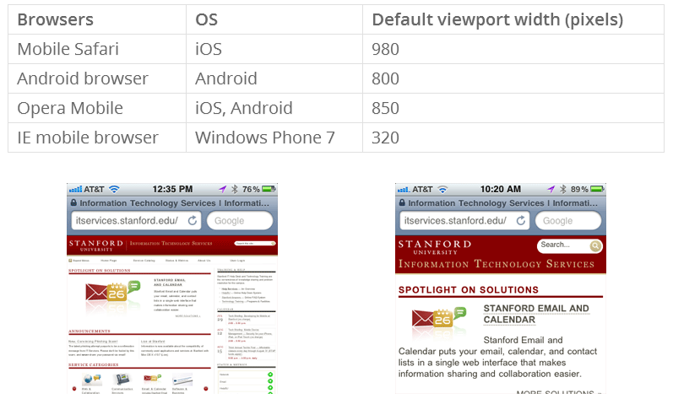
Default viewport widths
Viewport not set to width="device-width"
Viewport set to width="device-width"

Slide 43
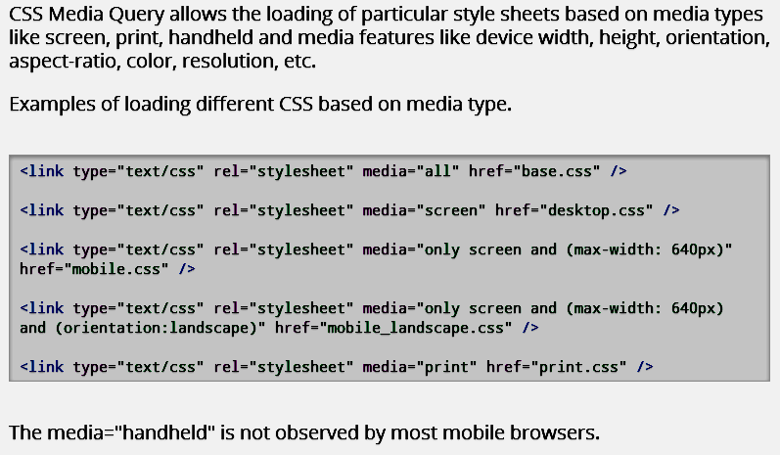
Media Queries

Slide 44
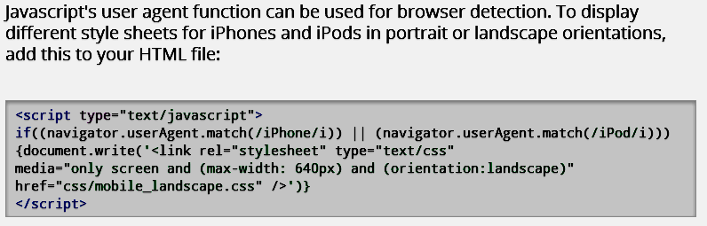
JavaScript

Slide 45
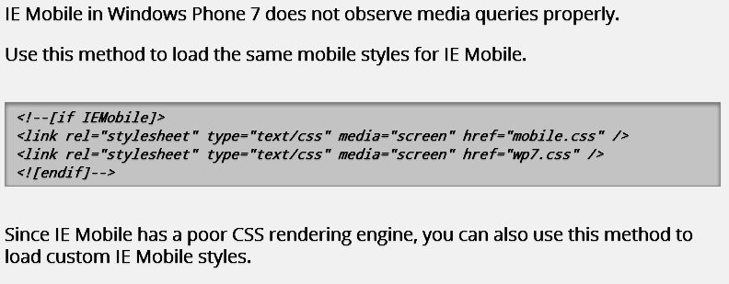
Internet Explorer/Windows Phone

Slide 46
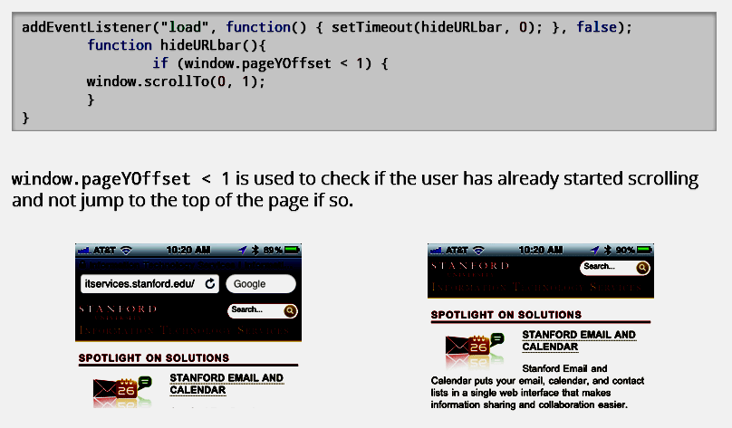
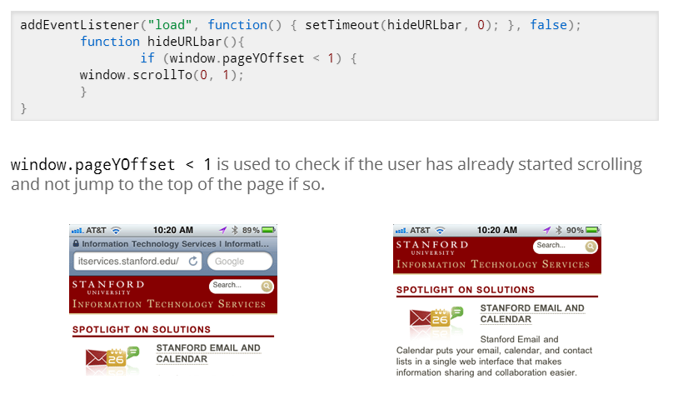
Hiding the Address Bar

Slide 47
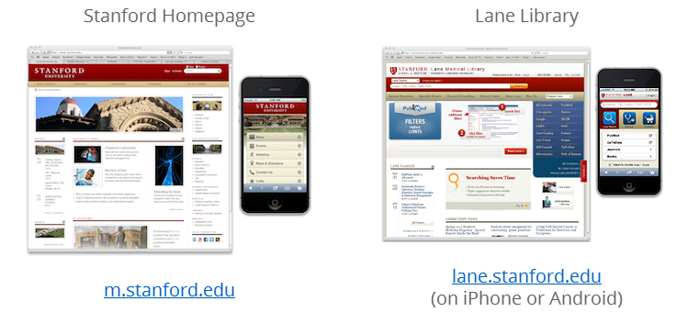
If you choose to have a separate mobile site…
…use jquery mobile: http://jquerymobile.com

Slide 48
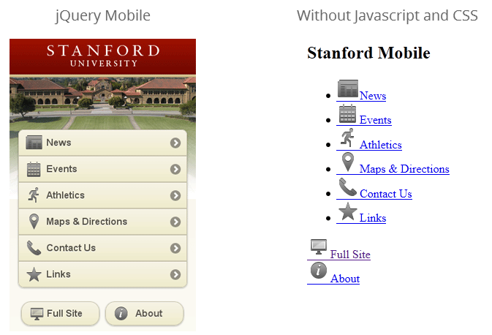
Why jquery mobile?

Slide 49
Responsive design sites
Boston Globe: http://bostonglobe.com/
Stanford IT Services: http://itservices.stanford.edu/
Smashing Magainze: http://smashingmagazine.com/

Slide 50
Twitter Bootstrap makes it easy!
What is Twitter Bootstrap?
A bunch of HTML, CSS, and Javascript files
Responsive design interaction components
Open-source
http://twitter.github.com/bootstrap/

Slide 51
Other Responsive Web Frameworks
Zurb Foundation: http://foundation.zurb.com
Skeleton: http://getskeleton.com
Less Framework: http://lessframework.com
Frameless Grid: http://framelessgrid.com
Amazium: http://www.amazium.co.uk

